Slide 1



Applied Data Analysis (CS401)
Lecture 13
Scaling to
data
13 Dec 2023
massive
Robert West
Notes:
2021: 4 minutes too long
2022: 2 minutes too long
2023: 5 minutes too long

Slide 2
Announcements
Homework H2
Feedback to be released later this week
Reminder (see Ed): Please participate in ML4Ed study by Fri 14:00
Project milestone P3 due next week (Fri 22 Dec)
Friday’s lab session:
Last lab session! → Last quiz (on lecture 12)
Project office hour (same sign-up protocol as last week)
Exercises on Spark (useful for your future projects, your job, your love life)
Course eval is available on IS-Academia!
Note: different from the eval from a few weeks ago!

Slide 3

Feedback
Give us feedback on this lecture here: https://go.epfl.ch/ada2023-lec13-feedback
What did you (not) like about this lecture?
What was (not) well explained?
On what would you like more (fewer) details?
Where is Waldo?
…

Slide 4
So far in this class...
We made one big assumption:
All data fits on a single machine
Even more, all data fits into memory on a single machine (Pandas)
Realistic assumption for prototyping, but frequently not for production code

Slide 5
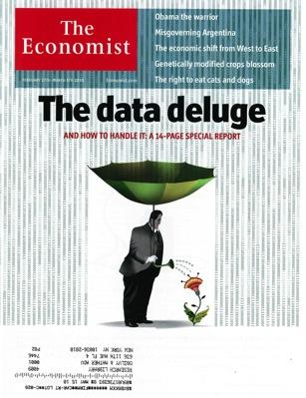
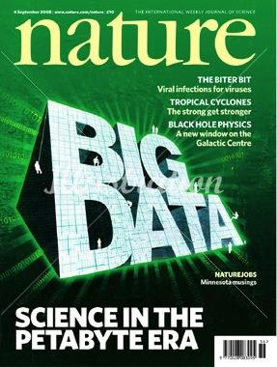

The big-data problem
Data is growing faster than computation speed
+ Growing data sources (e.g, Web, mobile, sensors, …)
+ Cheap hard-disk storage
– Stalling CPU speeds
– RAM bottlenecks
Notes:
A few TB of RAM ok, but not more (p.t.o.)

Slide 6

Examples
Facebook’s daily logs: 60 TB
1000 Genomes project: 200 TB
Google Web index: 100+ PB
Cost of 1 TB of disk: $50
Time to read 1 TB from disk: 3 hours (100 MB/s)
These numbers (anno domini 2016) are outdated (too small)!
Notes:
2016: 60 trillion webpages (100k 1-TB hard-drives)
Google: Had to add a zero when updating slides every year -- so I just stopped
...
$5M for Google’s HDDs
→ over 3 years to read all of Google’s Web index sequentially
FB: 1 week to read the data produced in 1 day

Slide 7
The big-data problem
A single machine can no longer store, let alone process, all the data
The only solution is to distribute over a large cluster of machines
Notes:
…
Before we go into how we could distribute: devil’s advocate: do you even need so much data?

Slide 8
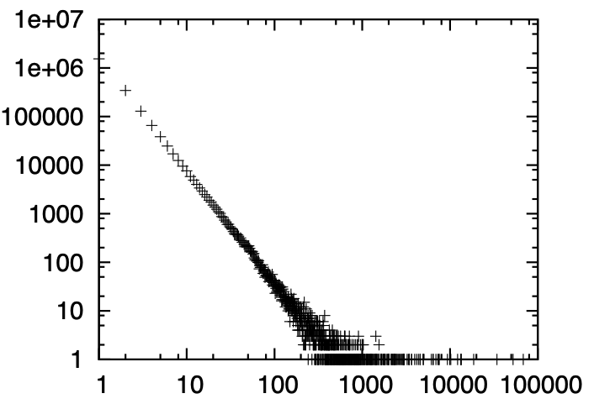
But how much data should you get?
Of course, “it depends”, but for many applications the answer is:
As much as you can get
Big data about people (text, Web, social media) tends to follow heavy-tailed distributions (e.g., power laws)
Example: Web search
Most queries occur only once or twice
Number of unique queries of freq x
59% of all Web search queries are unique
17% of all queries are made only twice
8% are made three times
x: search-query frequency
Notes:
E.g., search queries
linear on log-log → power law!
To see the long tail, you need a lot of data
Explain: Google’s dominance in the tail of rare queries
Plot source: Yahoo! https://dl.acm.org/doi/abs/10.1145/1935826.1935907
Distribution computed based on a sample of ~6m query instances
NB: numbers (59%, etc.) are not extracted from the plot, from another (now unknown…) source on the Web

Slide 9
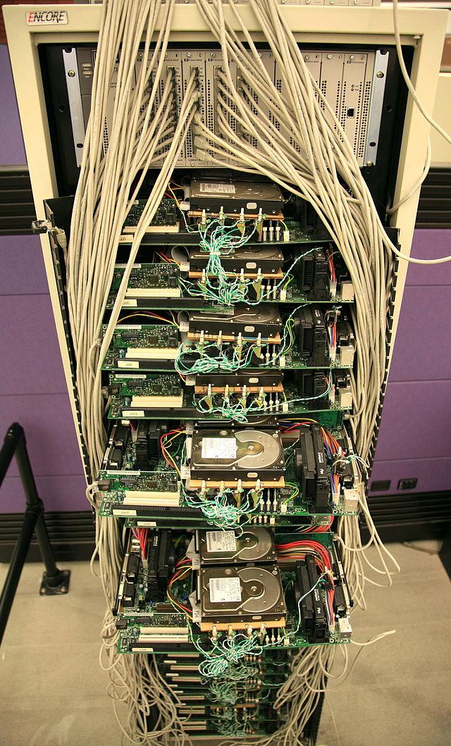
Hardware for big data
Budget (a.k.a. commodity) hardware
Not “gold-plated” (a.k.a. custom)
Many low-end servers
Easy to add capacity
Cheaper per CPU and per disk
Increased complexity in software:
Fault tolerance
Virtualization (e.g., distributed file systems)
Google Corkboard server: Steve Jurvetson/Flickr
Notes:
Ok, so for many use cases we actually need to store all that data
Next, let’s look at how we can do that
…
Tradeoff: simple hardware, complex software

Slide 10
Problems with cheap hardware
Failures, e.g. (Google numbers)
1–5% hard drives/year
0.2% DIMMs (dual in-line memory modules)/year
Commodity network (1–10 Gb/s) speeds vs. RAM
Much more latency (100–100,000x)
Lower throughput (100–1,000x)
Uneven performance
Inconsistent hardware (e.g., old + new)
Variable network latency
External loads
These numbers are constantly changing thanks to new technology!
Notes:
1% of 1M servers (w/ 1 HDD each) = 10k HDDs per year
Inconsistent HW: e.g., heterogeneous hardware, some new, some old
Variable network latency: e.g., some connections span longer distances
External loads: cluster shared among many applications; e.g., Gmail + serving search results

Slide 11
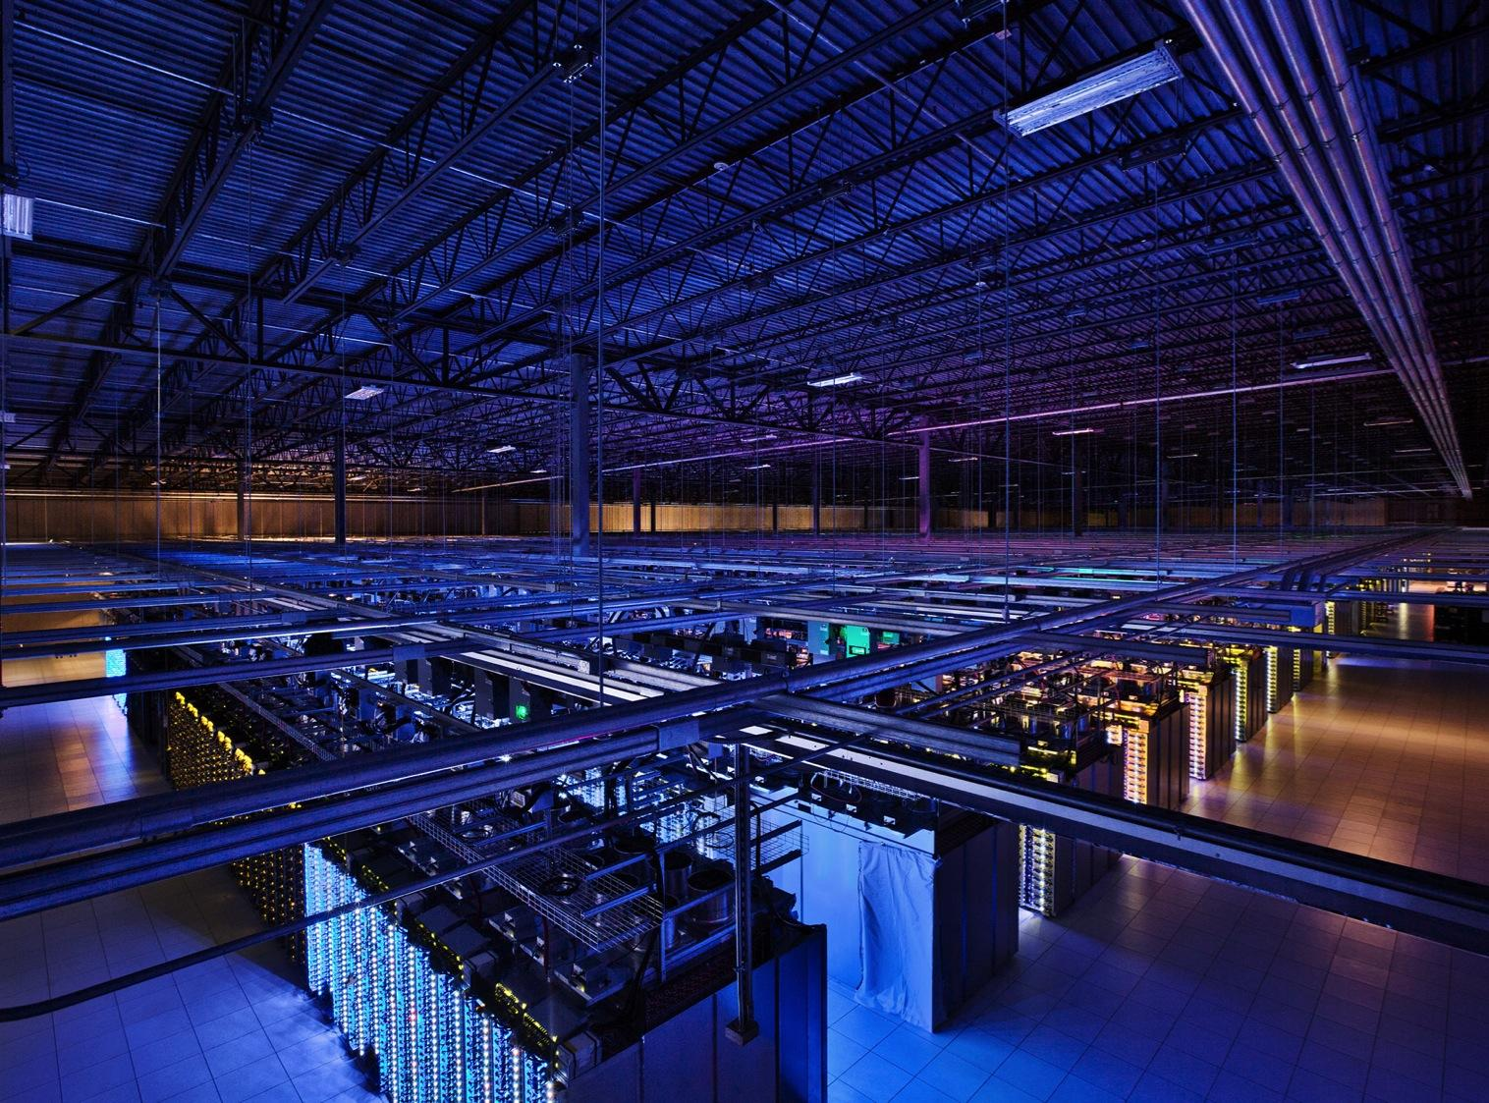
Google datacenter
How to program this thing?

Slide 12
What’s hard about cluster computing?
1. How to split work across machines?
2. How to deal with failures?

Slide 13
How do you count the number of occurrences of each word in a document?
“I am Sam
I am Sam
Sam I am
Do you like
Green eggs and ham?”
I: 3
am: 3
Sam: 3
do: 1
you: 1
like: 1
…
Notes:
Let’s start with a typical task that you do all the time
Let’s first look at how you do this if the data is small and fits easily on your laptop
Ask: How would you compute this mapping in Python?

Slide 14
A hashtable (a.k.a. dict)!
“I am Sam
I am Sam
Sam I am
Do you like
Green eggs and ham?”
{}

Slide 15
A hashtable!
“I am Sam
I am Sam
Sam I am
Do you like
Green eggs and ham?”
{I: 1}

Slide 16
A hashtable!
“I am Sam
I am Sam
Sam I am
Do you like
Green eggs and ham?”
{I: 1,
am: 1}

Slide 17
A hashtable!
“I am Sam
I am Sam
Sam I am
Do you like
Green eggs and ham?”
{I: 1,
am: 1,
Sam: 1}

Slide 18
A hashtable!
“I am Sam
I am Sam
Sam I am
Do you like
Green eggs and ham?”
{I: 2,
am: 1,
Sam: 1}

Slide 19
What if the document is really big?
Notes:
Say 1 TB
Sequentially reading data alone would take about 3 hours (if you’re lucky)

Slide 20
What if the document is really big?
“I am Sam
I am Sam
Sam I am
Do you like
Green eggs and ham?
I do not like them
Sam I am
I do not like
Green eggs and ham
Would you like...”
{I: 3,
am: 3,
Sam: 3
{I: 6,
am: 4,
Sam: 4,
do: 3
… }
{do: 2, … }
{Sam:1,
… }
{Would: 1, … }
Notes:
First stab
What’s the problem here?
[CLICK] Not using all our machines in second phase, but just one → bottleneck
E.g., URLs instead of words → maybe too many to fit onto one machine

Slide 21
“Divide and Conquer”
“I am Sam
I am Sam
Sam I am
Do you like
Green eggs and ham?
I do not like them
Sam I am
I do not like
Green eggs and ham
Would you like…”
{I: 3,
am: 3,
…}
{I: 6,
do: 3,
…}
{do: 1,
you: 1, … }
{am: 5,
Sam: 4
…}
{Sam: 1,
I: 1,
… }
{you: 2
…}
{Would: 1, you: 1,… }
{Would: 1
…}

Slide 22
“Divide and Conquer”
MAP
“I am Sam
I am Sam
Sam I am
Do you like
Green eggs and ham?
I do not like them
Sam I am
I do not like
Green eggs and ham
Would you like…”
{I: 3,
am: 3,
…}
{I: 6,
do: 3,
…}
{do: 1,
you: 1, … }
{am: 5,
Sam: 4
…}
{Sam: 1,
I: 1,
… }
{you: 2
…}
{Would: 1, you: 1,… }
{Would: 1
…}

Slide 23
“Divide and Conquer”
MAP
REDUCE
“I am Sam
I am Sam
Sam I am
Do you like
Green eggs and ham?
I do not like them
Sam I am
I do not like
Green eggs and ham
Would you like…”
{I: 3,
am: 3,
…}
{I: 6,
do: 3,
…}
{do: 1,
you: 1, … }
{am: 5,
Sam: 4
…}
{Sam: 1,
I: 1,
… }
{you: 2
…}
{Would: 1, you: 1,… }
{Would: 1
…}
Notes:
Map creates a key/value pair per element of input file
Reduce: all key/value pairs w/ same key are sent to same machine
Names come from functional programming
Many algorithms can be phrased within MR framework
A fun exercise!

Slide 24
Recall: What’s hard about cluster computing?
How to divide work across machines?
Moving data may be very expensive
Must consider network, data locality
How to deal with failures?
1 server fails every 3 years ⇒ 10K servers see~10 faults/day
Even worse: stragglers (node not failed, but slow)
Notes:
Programming the steps from the previous slides manually is an absolute nightmare
Why? Because of the two main factors that make cluster computing hard:
…
~ halting test

Slide 25
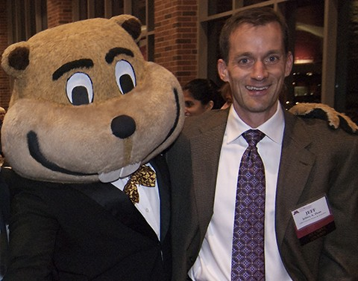

Solution: MapReduce
Smart systems engineers have done all the work for you
Task scheduling
Virtualization of file system
Fault tolerance (incl. data replication)
Job monitoring
etc.
“All” you need to do: implement Mapper and Reducer classes
Jeff Dean [facts]
Notes:
Also chief architect of TensorFlow, Gemini
Coffee machine

Slide 26
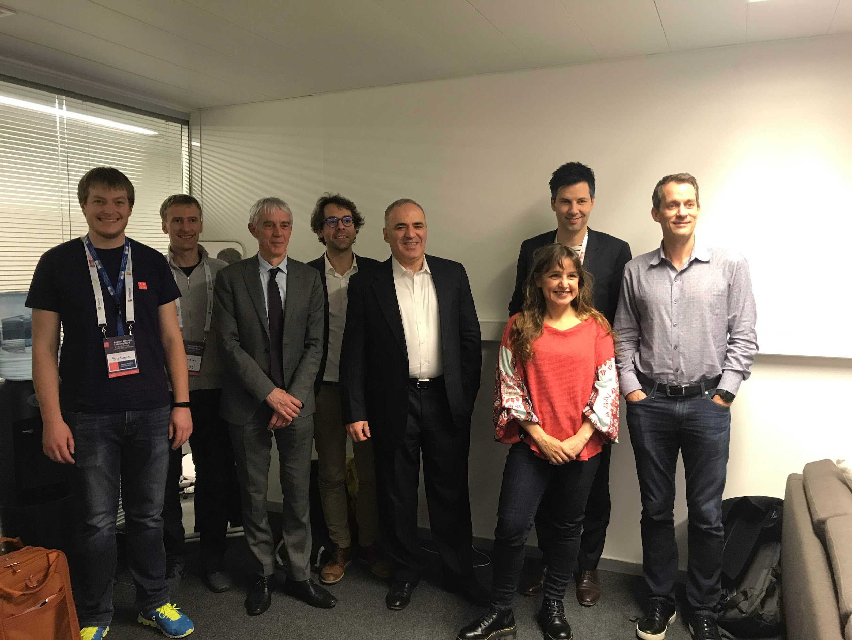
Applied Machine Learning Days ’19 [link]
Notes:
Who’s the man in the middle, next to Yours Truly?

Slide 27
How to deal with failures?
{I: 6,
do: 3,
…}
{3: do,
6: I,
… }
{am: 5,
Sam: 4
…}
{4: Sam,
5: am, … }
{you: 2
…}
{2: you,
… }
{Would: 1
…}
{1: would,… }
Just launch another task!

Slide 28
How to deal with slow tasks?
{I: 6,
do: 3,
…}
{3: do,
6: I,
… }
{4: Sam,
5: am, … }
Just launch another task!
{am: 5,
Sam: 4
…}
{you: 2
…}
{2: you,
… }
{Would: 1
…}
{1: would,… }

Slide 29
Solution: MapReduce
Smart systems engineers have done all the work for you
Task scheduling
Virtualization of file system
Fault tolerance (incl. data replication)
Job monitoring
etc.
“All” you need to do: implement Mapper and Reducer classes
Jeff Dean
Need to break more complex jobs into sequence of MapReduce jobs
Notes:
This (breaking tasks up) can be cumbersome, which is why I put “All” in quotation marks

Slide 30
Example task
Suppose you have user info in one file, website logs in another, and you need to find the top 5 pages most visited by users aged 18–25
Load Users
Load Pages
Filter by age
Join on name
Group on url
Count visits
Order by visits
Take top 5
Example from http://wiki.apache.org/pig-data/attachments/PigTalksPapers/attachments/ApacheConEurope09.ppt
Notes:
…
Also, imagine that you have 1 billion users and 10 billion page loads per day
Files are terabytes large
…

Slide 31
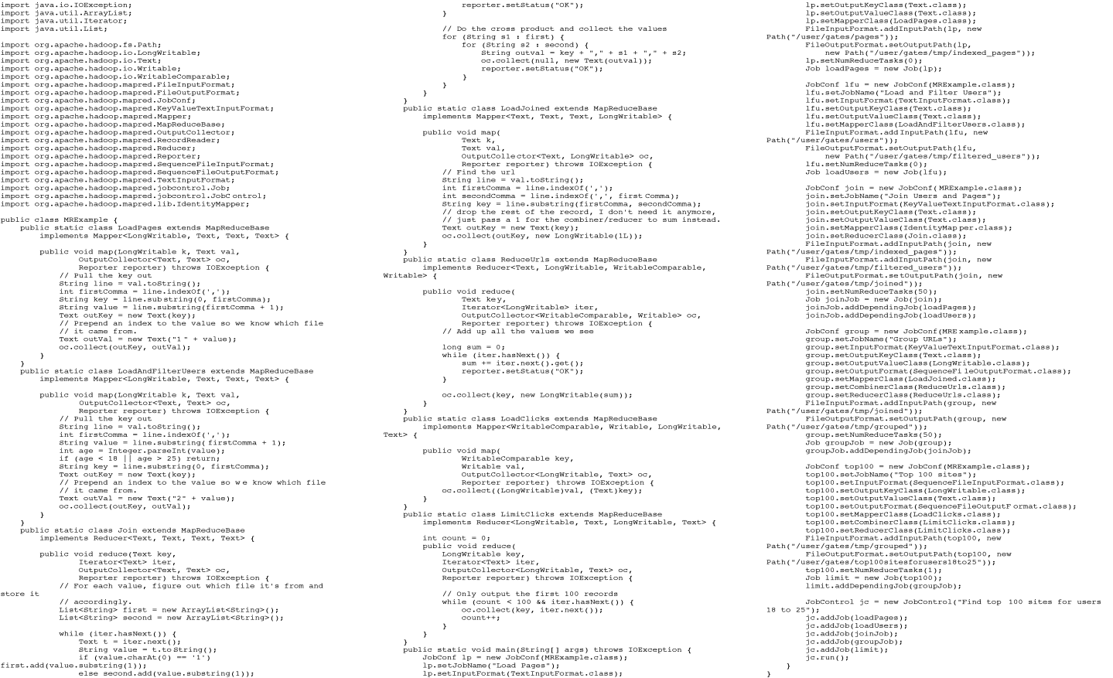
In MapReduce
Notes:
Already MUCH less than what it would be if you’d have to write code from scratch!

Slide 32
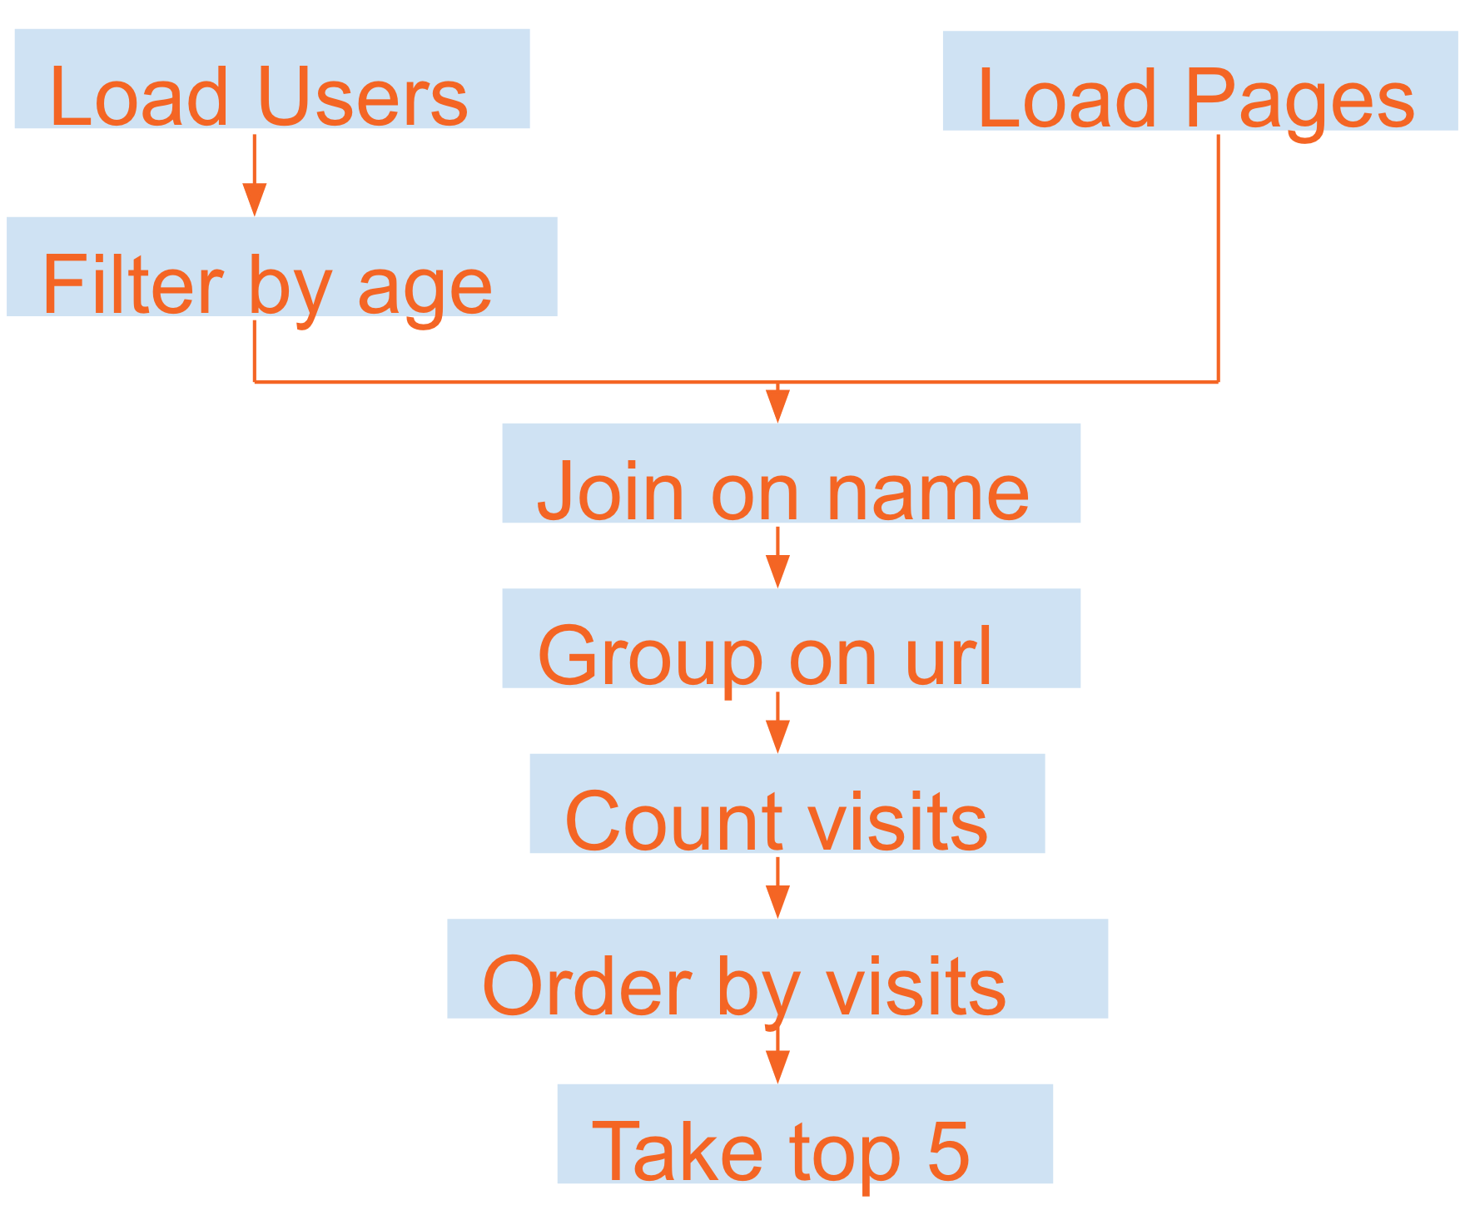

Enter: .
A high-level API for programming MapReduce-like jobs
sc = SparkContext()
print “I am a regular Python program, using the pyspark lib”
users = sc.textFile(‘users.tsv’) # user <TAB> age
.map(lambda s: tuple(s.split(‘\t’)))
.filter(lambda (user, age): age>=18 and age<=25) pages = sc.textFile(‘pageviews.tsv’) # user <TAB> url
.map(lambda s: tuple(s.split(‘\t’))) counts = users.join(pages)
.map(lambda (user, (age, url)): (url, 1)
.reduceByKey(add)
.takeOrdered(5)
Notes:
Closely mirrors conceptual flowchart, much more so than MapReduce code
(no need to understand code in detail at this point; just get an impression of how different it is from raw MR code)

Slide 33


Implemented in (go EPFL!)
Additional APIs in
Python
Java
R
Notes:
Staircase in BC building

Slide 34

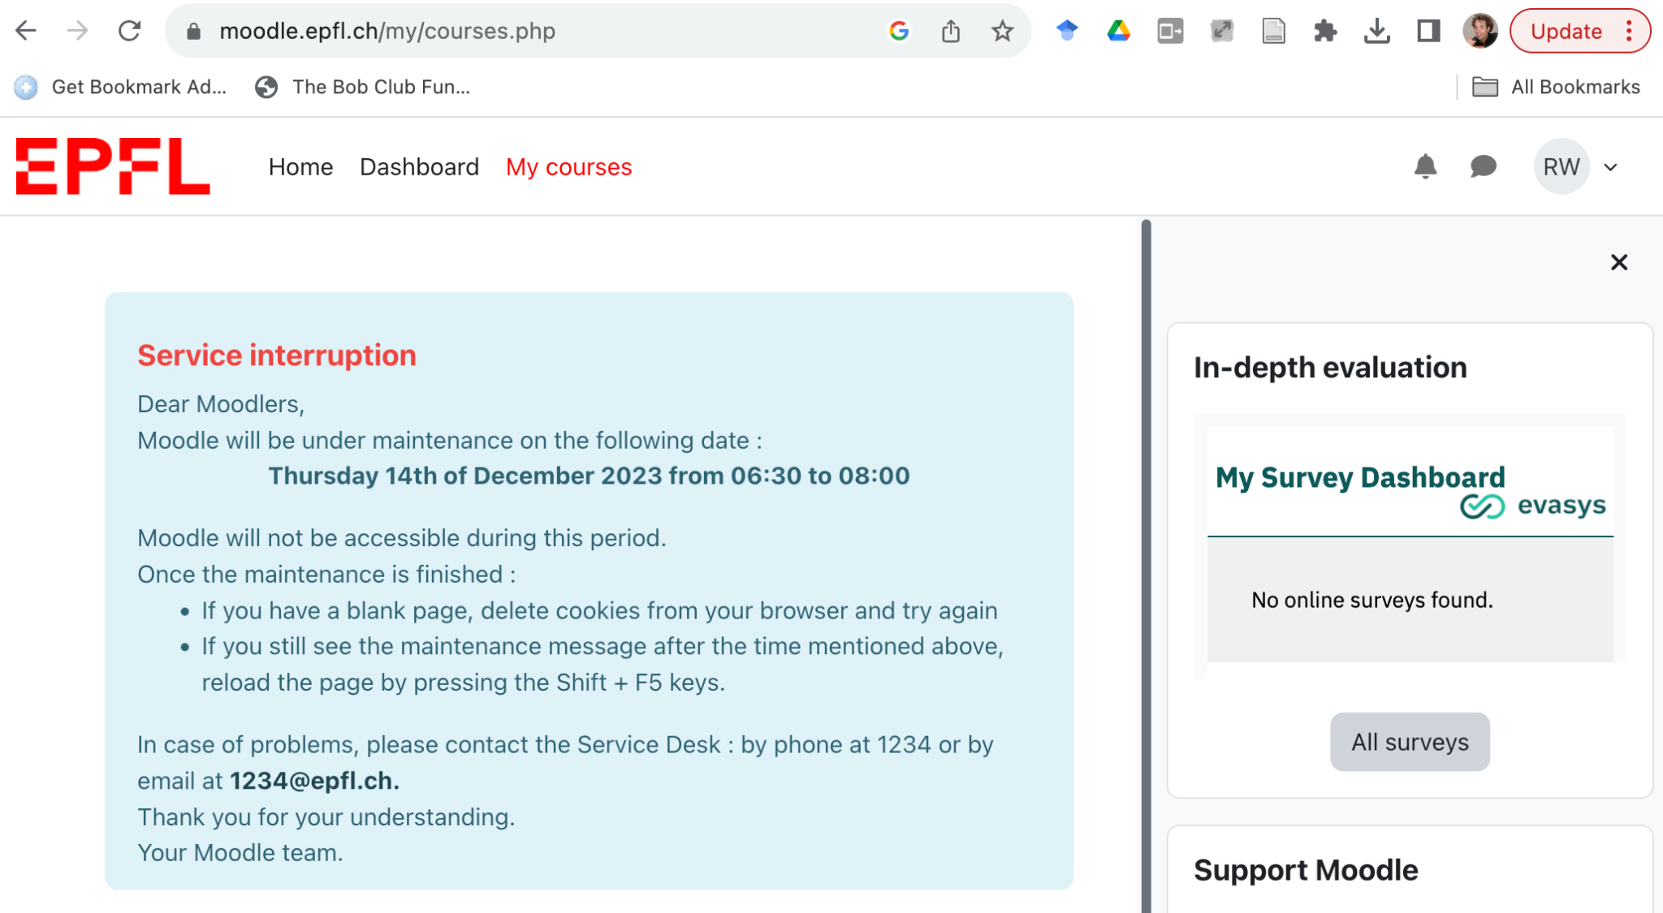
Commercial break

Slide 35
RDD: resilient distributed dataset
To programmer: looks like one single list (each element represents a “row” of a dataset)
Under the hood: oh boy…
RDDs “live in the cloud”: split over several machines, replicated, etc.
Can be processed in parallel
Can be transformed to a single, real list (if small…)
Typically read from the distributed file system (HDFS)
Can be written to the distributed file system
Notes:
The key data structure of Spark

Slide 36
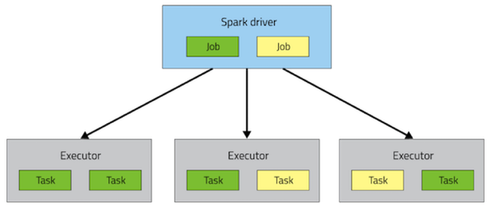
. architecture
Your Python script runs in the driver (“ground”)
RDD operations
are run in executors
(“cloud”)
Notes:
Can run multiple jobs in parallel
Executors == machines, usually each w/ multiple CPUs
Tasks == parts of a job (one task per chunk)
Each task done by one CPU; can execute multiple (but not necessarily all) tasks in parallel on the same executor

Slide 37
RDD operations
“Transformations”
Input: RDD; output: another RDD
Everything remains “in the cloud”
Example: for every entry in the input RDD, count chars
RDD:[‘I’, ‘am’, ‘you’] → RDD:[1, 2, 3]
“Actions”
Input: RDD; output: a value that is returned to the driver
Result is transferred “from cloud to ground”
Examples: take a sample of entries from RDD and print it on the driver’s shell; or store results to file (local or distributed)

Slide 38
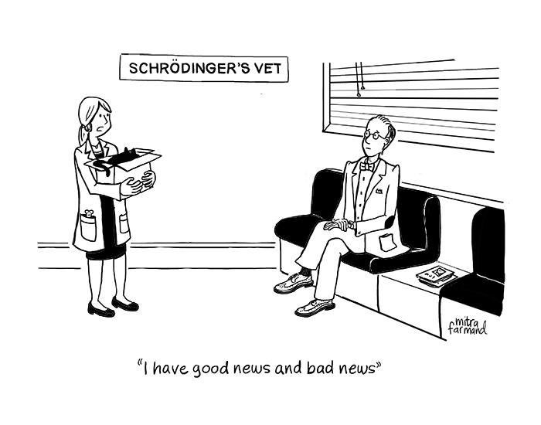
Lazy execution [unrelated]
Transformations (i.e., RDD→RDD operations) are not executed until it’s really necessary (a.k.a. “lazy execution”)
Execution of transformations triggered by actions
Why?
If you never look at the data, there’s no point in manipulating it…
Smarter query processing possible: E.g., rdd2 = rdd1.map(f1) rdd3 = rdd2.filter(f2) Can be done in one go — no need to materialize rdd2

Slide 39
RDD transformations [full list]
map(func): Return a new distributed dataset formed by passing each element of the source through a function func
{1,2,3}.map(lambda x: x*2) → {2,4,6}
filter(func): Return a new dataset formed by selecting those elements of the source on which func returns true
{1,2,3}.filter(lambda x: x <= 2) → {1,2}
flatMap(func): Similar to map, but each input item can be mapped to 0 or more output items (so func should return a list rather than a single item)
{1,2,3}.flatMap(lambda x: [x,x*10]) → {1,10,2,20,3,30}
Notes:
{1,2,3}: simplified notation for RDD
“{}” to emphasize set character: by default, RDDs are unordered

Slide 40
RDD transformations [full list]
sample(withReplacement?, fraction, seed): Sample a fraction fraction of the data, with or without replacement, using a given random number generator seed
union(otherDataset): Return a new dataset that contains the union of the elements in the source dataset and the argument.
intersection(otherDataset): …
distinct(): Return a new dataset that contains the distinct elements of the source dataset.

Slide 41


RDD transformations [full list]
sample(withReplacement?, fraction, seed): Sample a fraction fraction of the data, with or without replacement, using a given random number generator seed
Why relative fraction, and not absolute number?
POLLING TIME
Scan QR code or go to https://web.speakup.info/room/join/66626
Notes:
Poll:
Spark sample(): Why can’t you specify an absolute number (rather than a relative fraction) of required samples? (A) Because you rarely need a fixed absolute number of samples
(B) Because of the central limit theorem
(C) Because drawing an absolute number of samples would require cross-machine coördination

Slide 42
RDD transformations [full list]
groupByKey(): When called on a dataset of (K, V) pairs, returns a dataset of (K, Iterable<V>) pairs.
{(1,a), (2,b), (1,c)}.groupByKey() → {(1,[a,c]), (2,[b])}
reduceByKey(func): When called on a dataset of (K, V) pairs, returns a dataset of (K, V) pairs where the values for each key are aggregated using the given reduce function func, which must be of type (V, V) => V.
{(1, 3.1), (2, 2.1), (1, 1.3)}.reduceByKey(lambda (x,y): x+y) → {(1, 4.4), (2, 2.1)}
Notes:
reduceByKey = groupByKey, plus extra processing done within each group
reduceByKey: properties that func must have? (hint: RDDs are unordered)
Commutative, associative
Counterexamples: minus, divided, matrix mult

Slide 43
RDD transformations [full list]
sortByKey(): When called on a dataset of (K, V) pairs, returns a dataset of (K, V) pairs sorted by keys
join(otherDataset): When called on datasets of type (K, V) and (K, W), returns a dataset of (K, (V, W)) pairs with all pairs of elements for each key
{(1,a), (2,b)}.join({(1,A), (1,X)}) → {(1, (a,A)), (1, (a,X))}
Analogous: leftOuterJoin, rightOuterJoin, fullOuterJoin
(There are several other RDD transformations, and some of the above have additional arguments; cf. tutorial)
Notes:
Take-home task: try to come up with an implementation of sortByKey() in MapReduce
sampling! http://blog.ditullio.fr/2016/01/04/hadoop-basics-total-order-sorting-mapreduce/

Slide 44
RDD actions [full list]
collect(): Return all the elements of the dataset as an array at the driver program. This is usually useful after a filter or other operation that returns a sufficiently small subset of the data.
count(): Return the number of elements in the dataset.
take(n): Return an array with the “first” n elements of the dataset.
saveAsTextFile(path): Write the elements of the dataset as a text file in a given directory in the local filesystem or HDFS.
(There are several other RDD actions; cf. tutorial)
Notes:
We turn the page from transformations to actions
…
take(): “first” in quotation marks because not guaranteed to be smallest elements across entire distributed dataset (but also not random)
Until you call such an action, no actual data processing happens!

Slide 45
Broadcast variables
my_set = set(range(1e80)) rdd2 = rdd1.filter(lambda x: x in my_set) ^ This is a bad idea: my_set needs to be shipped with every task (one task per data partition, so if rdd1 is spread over N partitions, the above will require copying the same object N times)
Better: my_set = sc.broadcast(set(range(1e80))) rdd2 = rdd1.filter(lambda x: x in my_set.value) ^ This way, my_set is copied to each executor only once and persists across all tasks (one per partition) on the same executor
Broadcast variables are read-only
Notes:
Same executor (i.e., machine) generally processes many partitions
…
Why read only?

Slide 46
Accumulators
def f(x): return x*2 rdd2 = rdd1.map(f) ^ How can we easily know how many rows there are in rdd1 (without running a costly reduce operation)?
Side effects via accumulators! counter = sc.accumulator(0) def f(x): counter.add(1); return x*2 rdd2 = rdd1.map(f)
Accumulators are write-only (“add-only”) for executors
Only driver can read the value: counter.value
Notes:
Why is adding in parallel not a problem?
Properties of f? Commutative, associative
Why not readable?
Can read only after an action was executed

Slide 47
RDD persistence
}
rdd2 = rdd1.map(f1)
list1 = rdd2.filter(f2).collect()
list2 = rdd2.filter(f3).collect()
rdd2 = rdd1.map(f1)
rdd2.persist()
list1 = rdd2.filter(f2).collect()
list2 = rdd2.filter(f3).collect()
rdd1.map(f1) transformation is executed twice
Result of rdd1.map(f1) transformation is cached and reused (can choose between memory and disk for caching)
}
Notes:
Recall: collect() is an action, i.e., it triggers transformations to be executed
Classic tradeoff: computation time vs. memory space
“Is persist() a transformation or an action?”

Slide 48
Spark DataFrames
Bridging the gap between your experience with Pandas and the need for distributed computing
RDD = list of rows
DataFrame = table with rows and typed columns
Important to understand what RDDs are and what they offer, but today most of the tasks can be accomplished with DataFrames (higher level of abstraction ⇒ less code)
https://www.databricks.com/spark/getting-started-with-apache-spark/dataframes

Slide 49

Spark SQL [link]
sc = SparkContext()
sqlContext = HiveContext(sc)
df = sqlContext.sql("SELECT * from table1 GROUP BY id")

Slide 50
Spark’s Machine Learning Toolkit
MLlib: Algorithms [more details]
Classification
Logistic regression, decision trees, random forests
Regression
Linear (with L1 or L2 regularization)
Unsupervised:
Alternating least squares
K-means
SVD
Topic modeling (LDA)
Optimizers
Optimization primitives (SGD, L-BGFS)

Slide 51
Example:
Logistic regression with MLLib
from pyspark.mllib.classification \
import LogisticRegressionWithSGD
trainData = sc.textFile("...").map(...) testData = sc.textFile("...").map(...)
model = LogisticRegressionWithSGD.train(trainData)
predictions = model.predict(testData)
Notes:
Should remind you of scikit-learn

Slide 52

Remarks
This lecture is not enough to teach you Spark!
To use it in practice, you’ll need to delve into further online material
Also: Friday’s lab session
You can’t learn it without some frustration :(
Important skill: assess whether you’d benefit from Spark
E.g., >1TB: yes, you’ll need Spark
20GB: it depends…
Notes:
Paradoxical: to feel the Spark, you need a thick skin (like an elephant)...

Slide 53
Feedback
Give us feedback on this lecture here: https://go.epfl.ch/ada2023-lec13-feedback
What did you (not) like about this lecture?
What was (not) well explained?
On what would you like more (fewer) details?
Where is Waldo?
…

Slide 54
Cluster etiquette
Develop and debug locally
Install Spark locally on your personal computer
Use a small subset of the data
When ready, launch your script on the cluster using spark-submit
Never (never!) use the Spark shell (a.k.a. pyspark) -- it’s hereby officially forbidden
Useful trench report from a dlab member: “What I learned from processing big data with Spark”

